Slide 1

FB vs BMS/BNF with Reduction

Slide 2

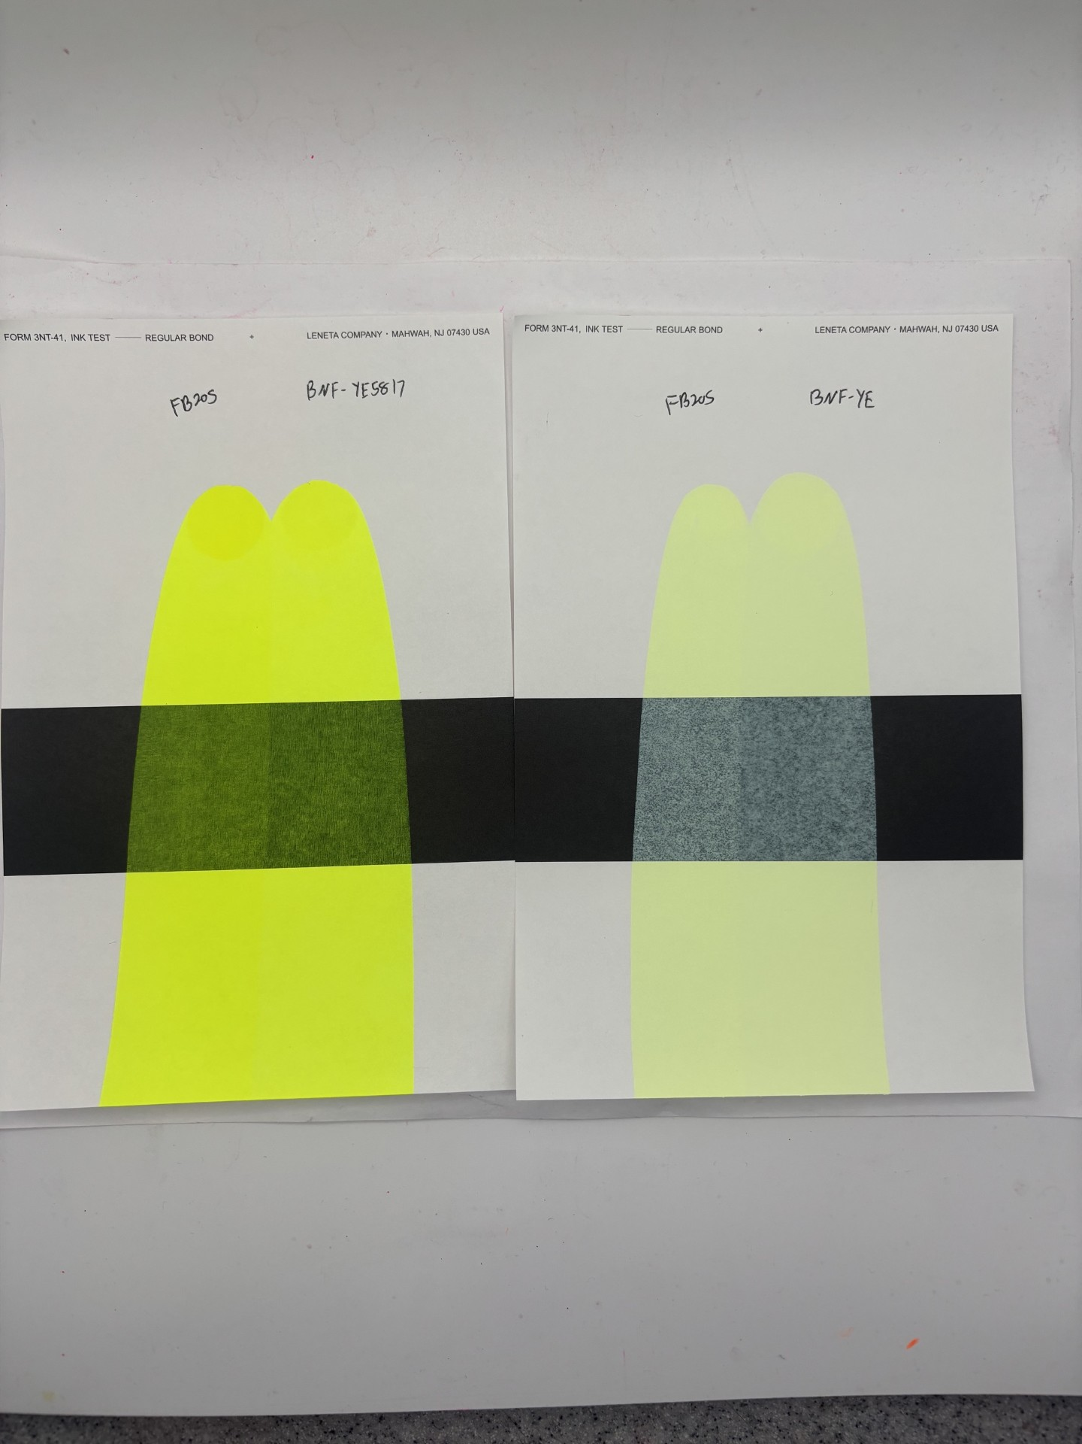
FB205 vs BNF-YE5817
Masstone
Tint

Slide 3
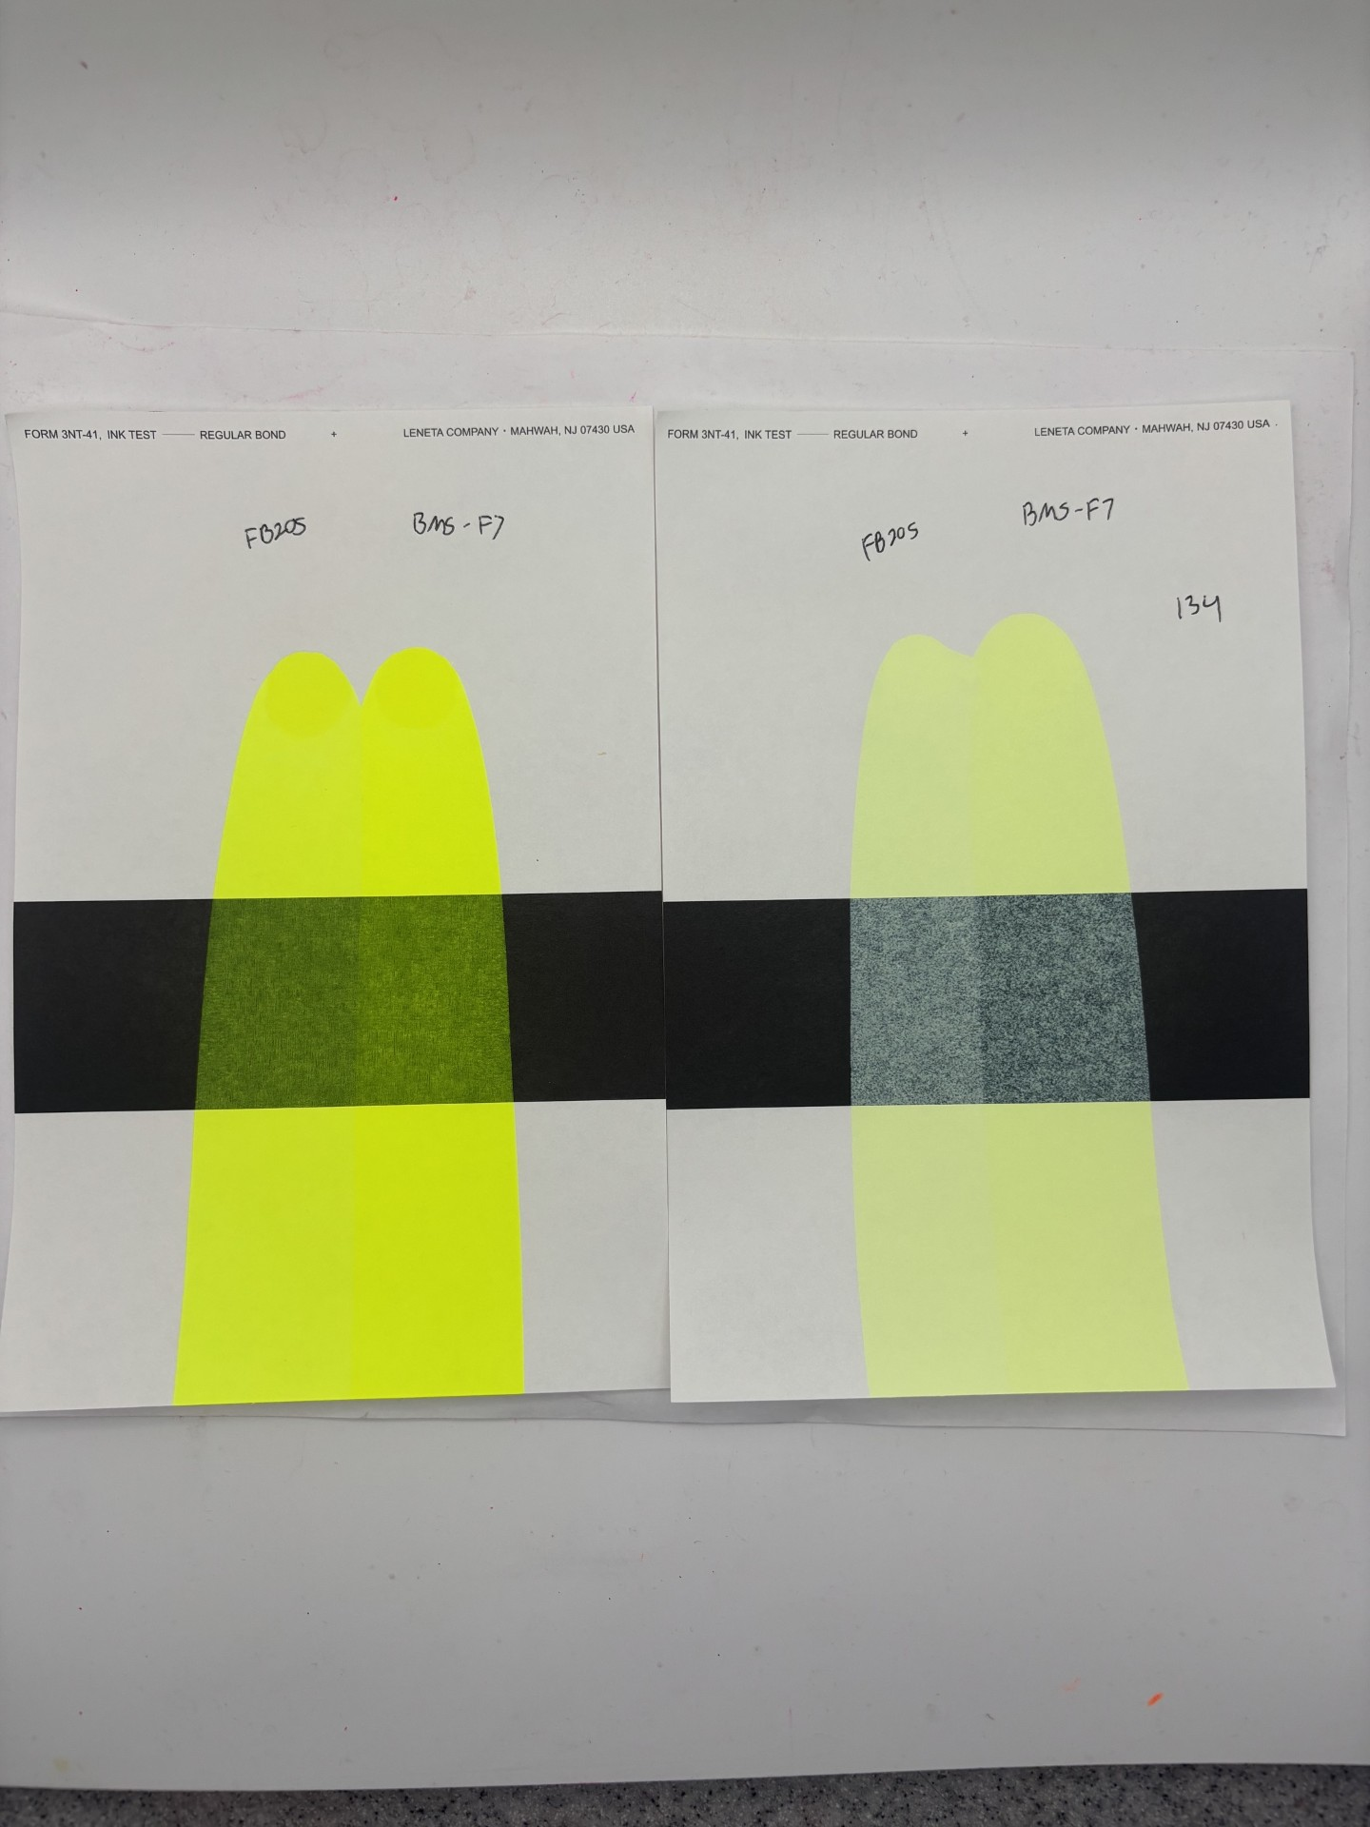
FB205 vs BMS F7
Masstone
Tint

Slide 4
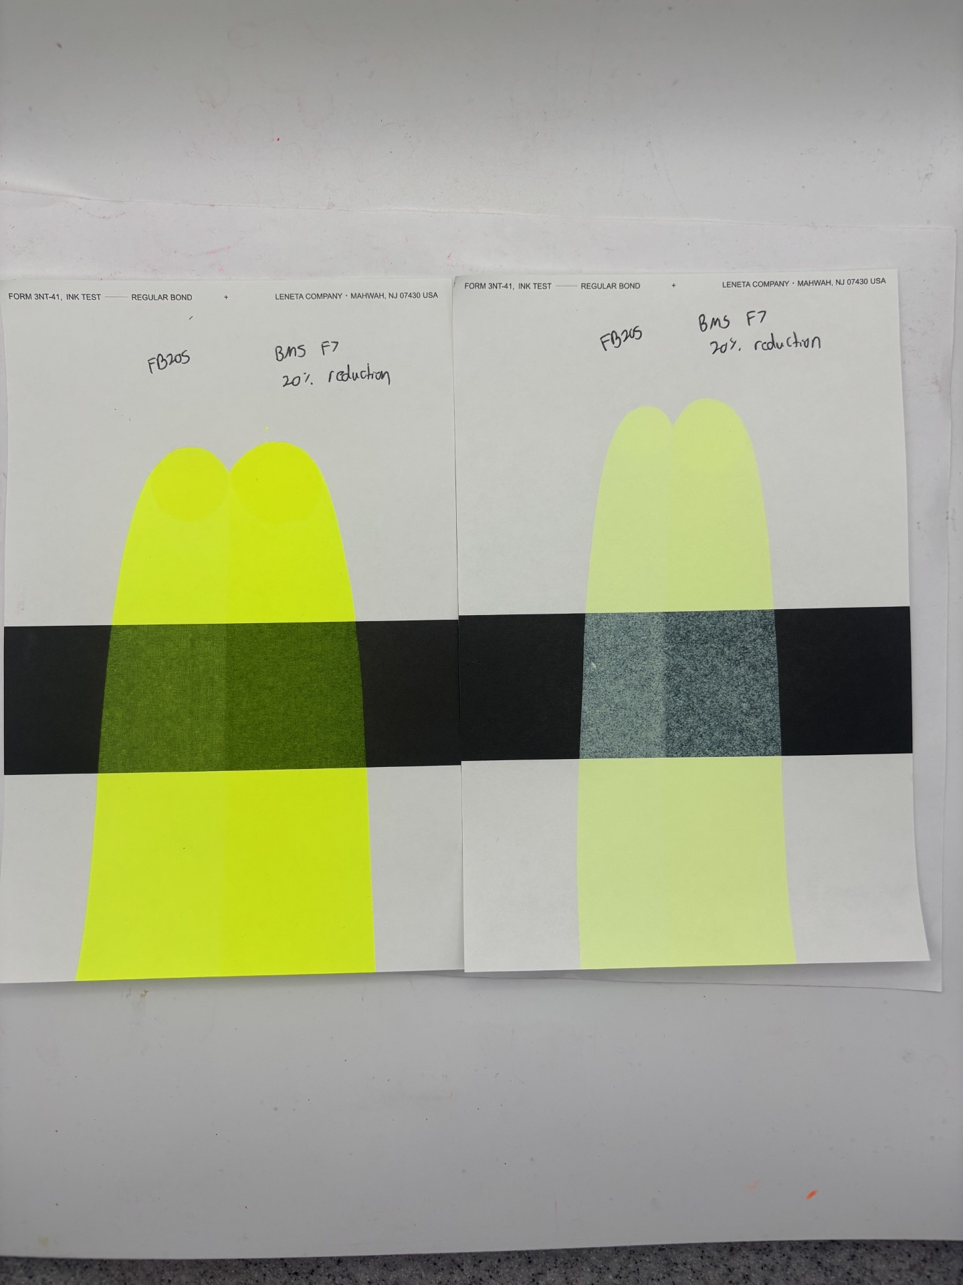
FB205 vs BMS F7
20% Reduction
Masstone
Tint

Slide 5
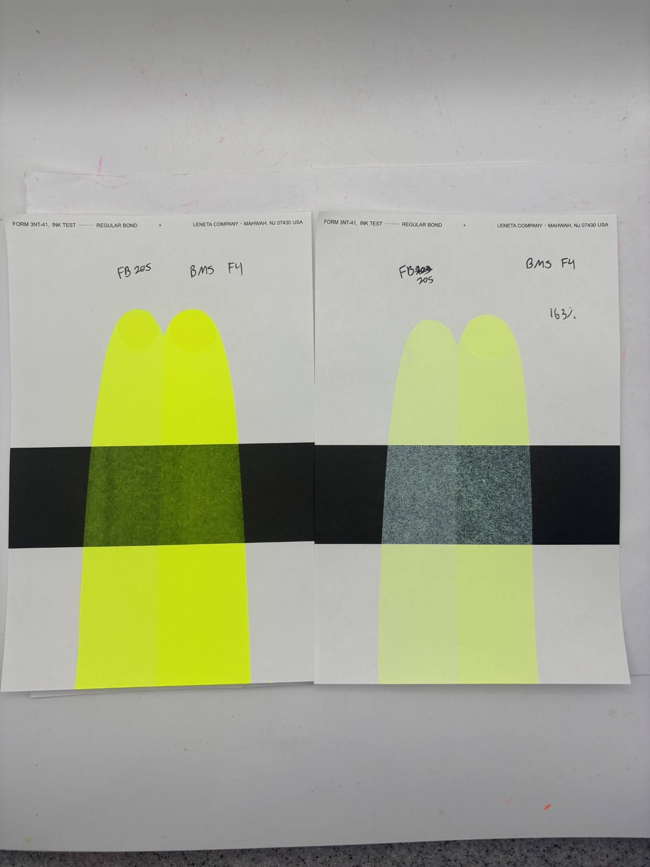
FB205 vs BMS F4
Masstone
Tint

Slide 6
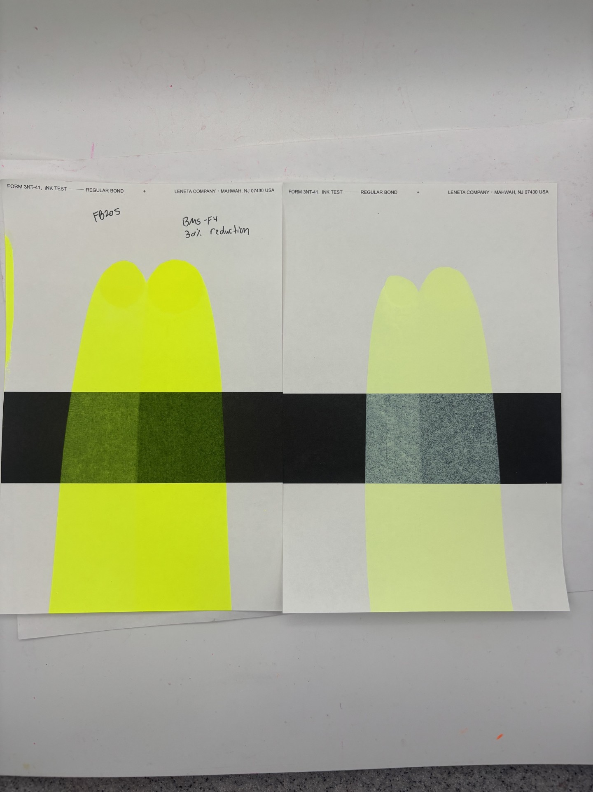
FB205 vs BMS F4
30% Reduction
Masstone
Tint

Slide 7
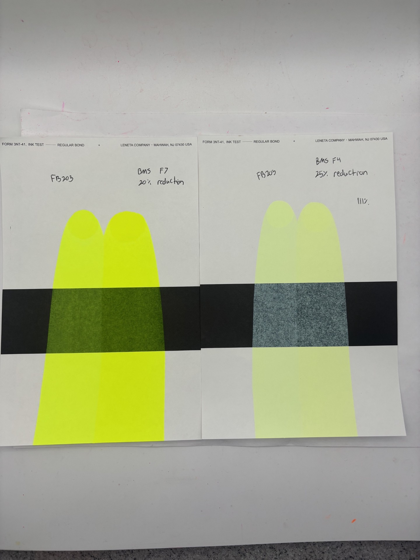
FB203 vs BMS F7
20% Reduction
Masstone
Tint

Slide 8
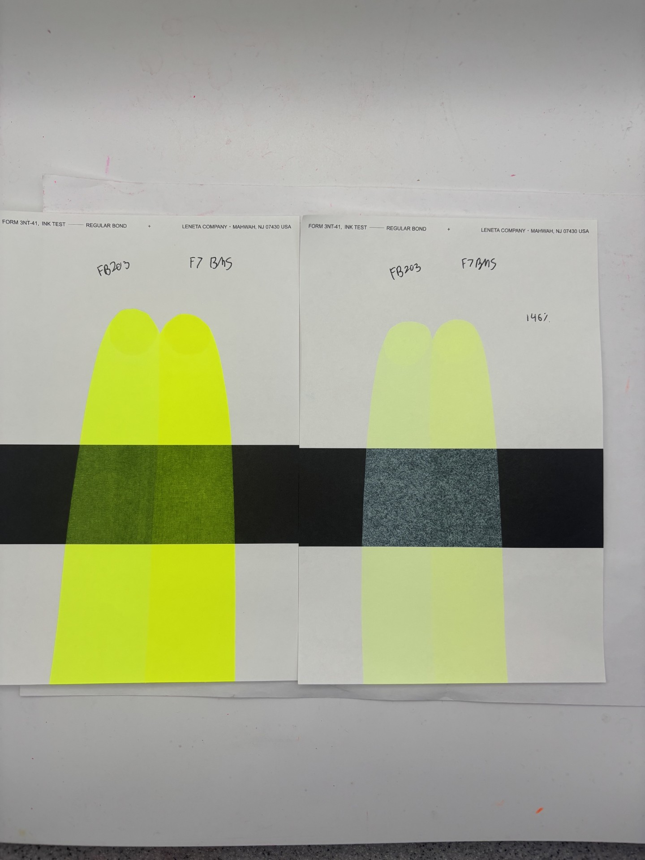
FB203 vs BMS F7
Masstone
Tint

Slide 9
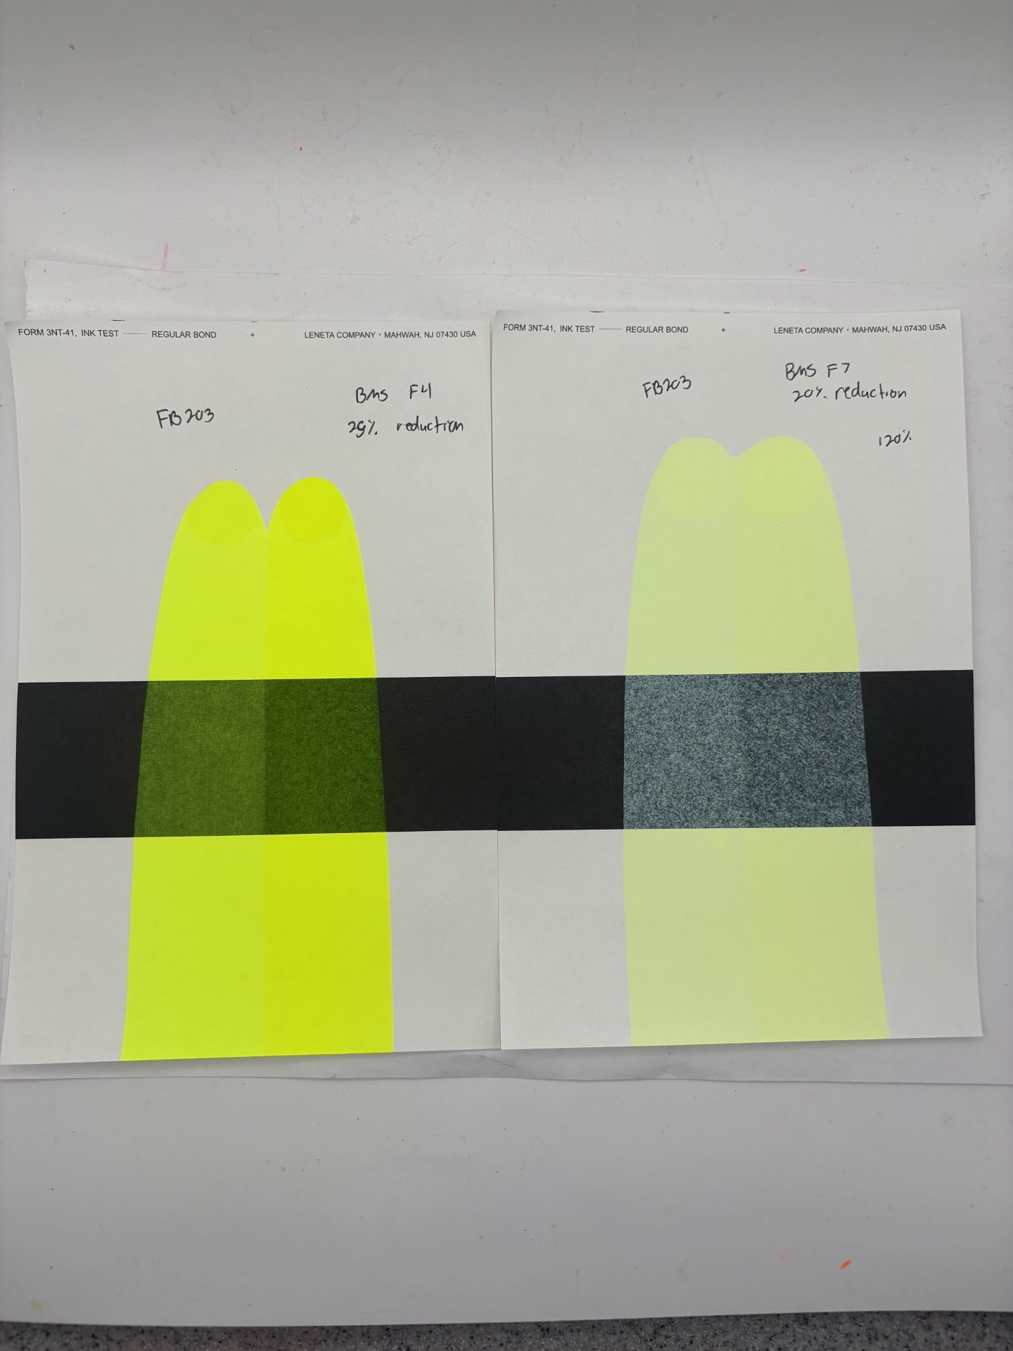
FB203 vs BMS F4
25% Reduction
Masstone
Tint

Slide 10
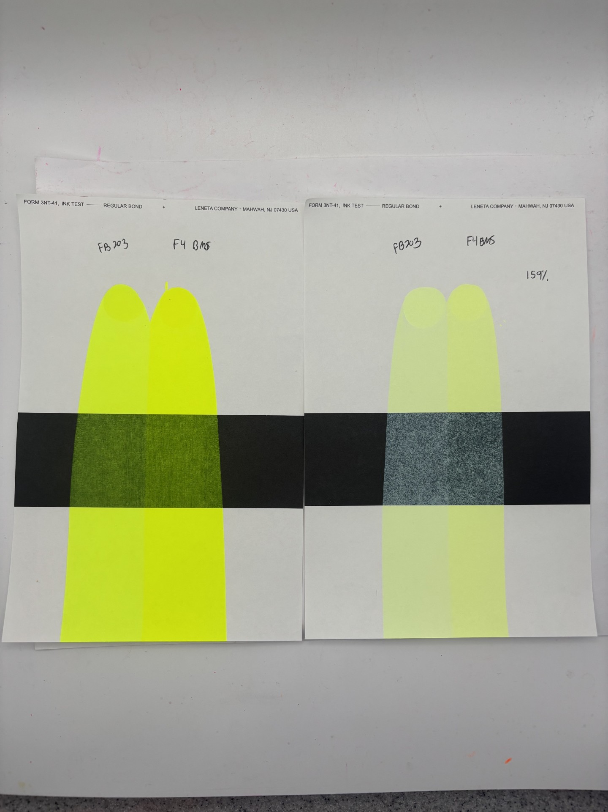
FB203 vs BMS F4
Masstone
Tint

Slide 11
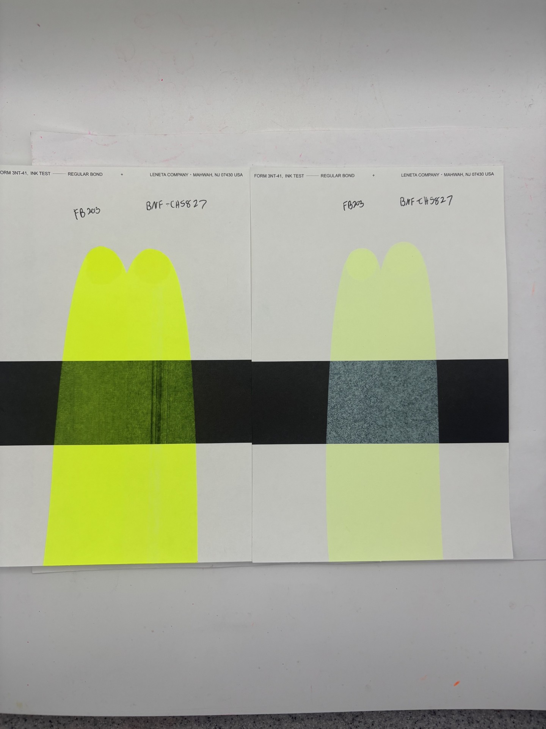
FB203 vs BNF-CH5827
Masstone
Tint

