Slide 1

BNF-CH527 vs Fine Grind

Slide 2

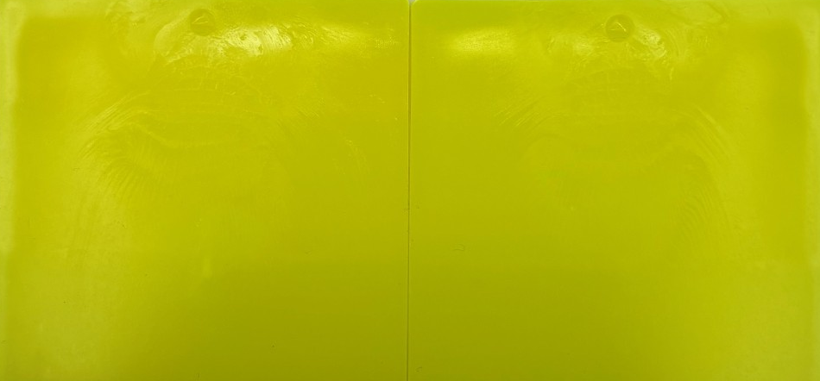
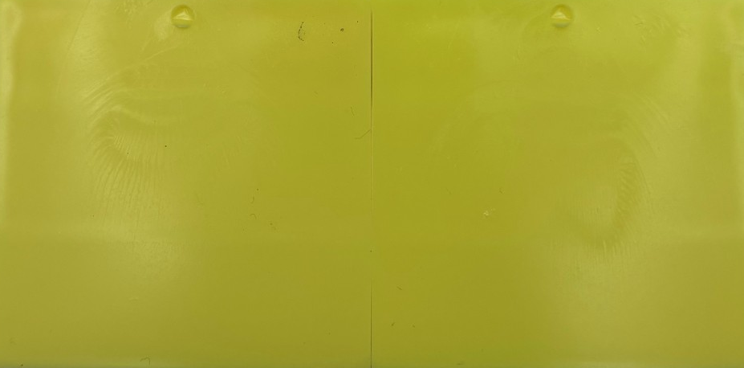
Masstone and Tint
BNF-CH527
BNF-CH527 FG
BNF-CH527
BNF-CH527 FG
DE: 1.53
Strength: 108%

Slide 3
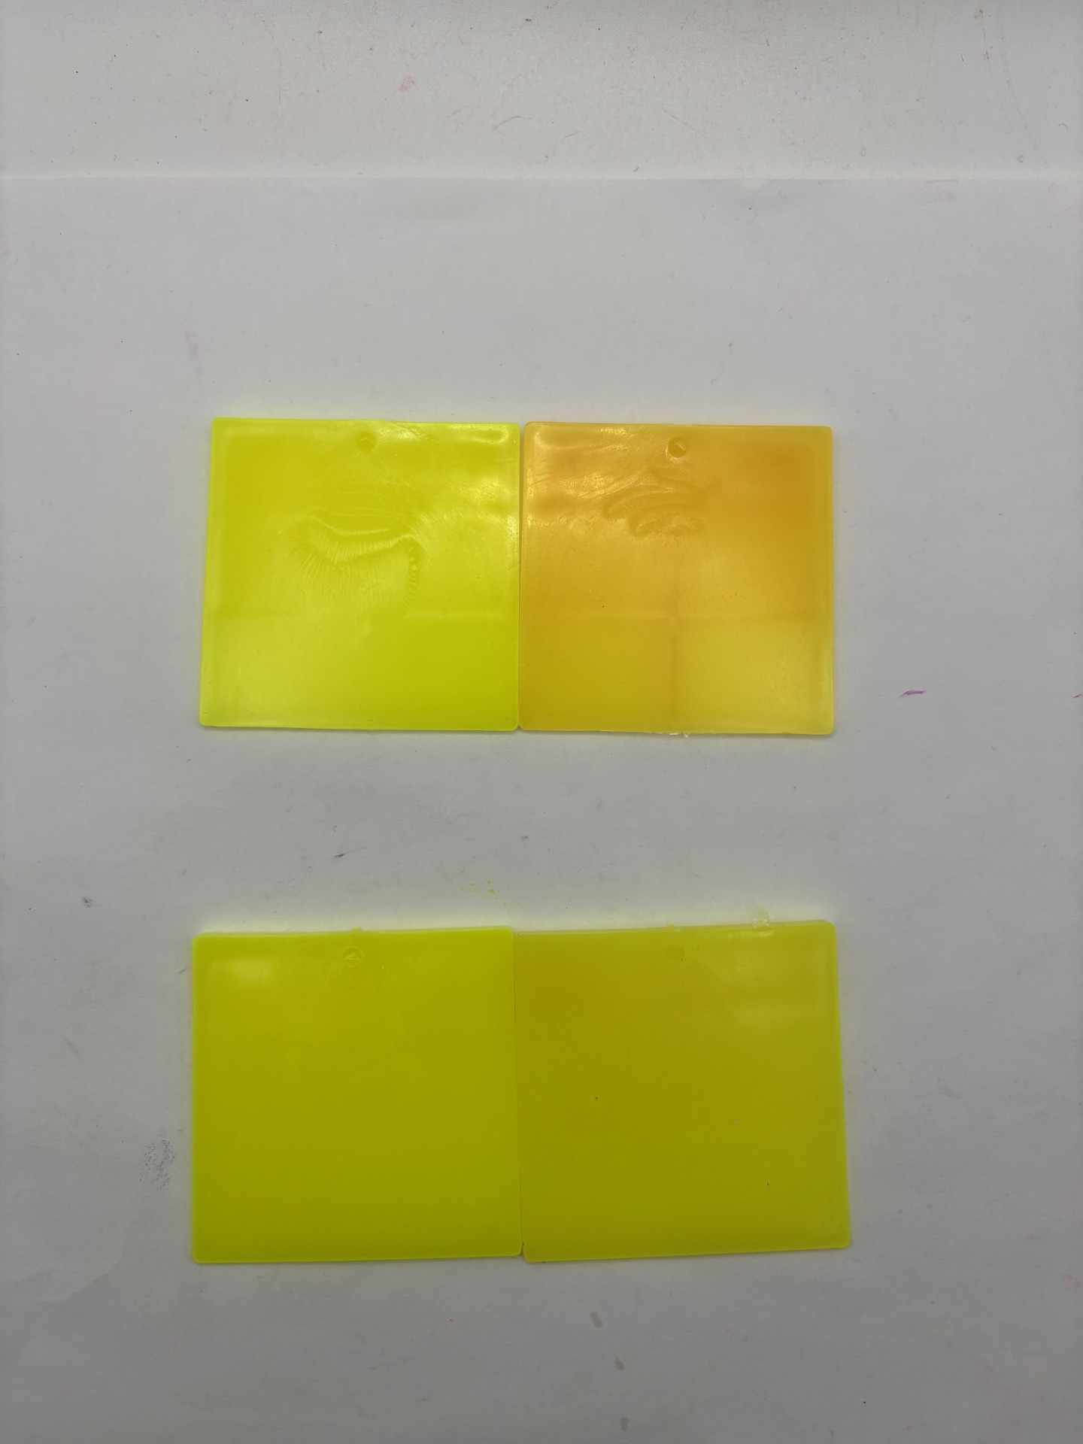
Heat Stability
BNF-CH527
5 min, 300C Hold
BNF-CH527 Fine Grind
5 min, 300C Hold
DE: 16.30
DE: 8.11

Slide 4
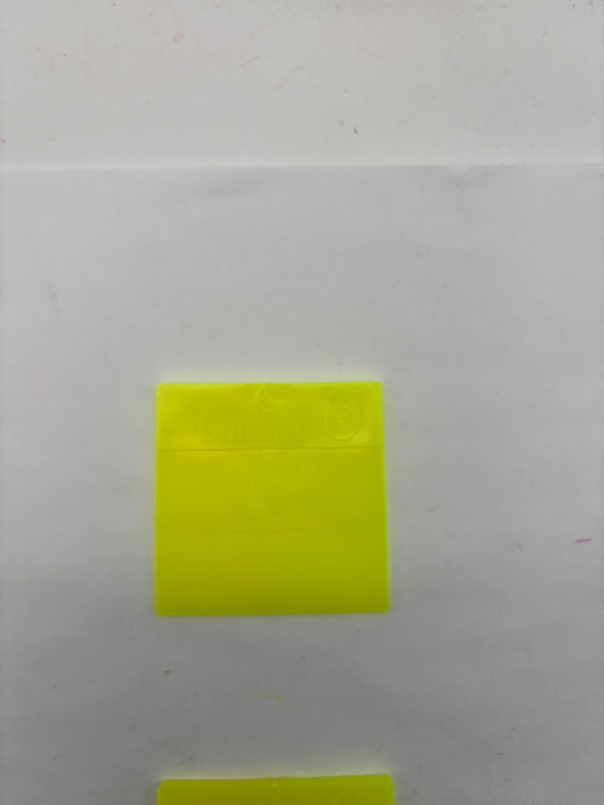
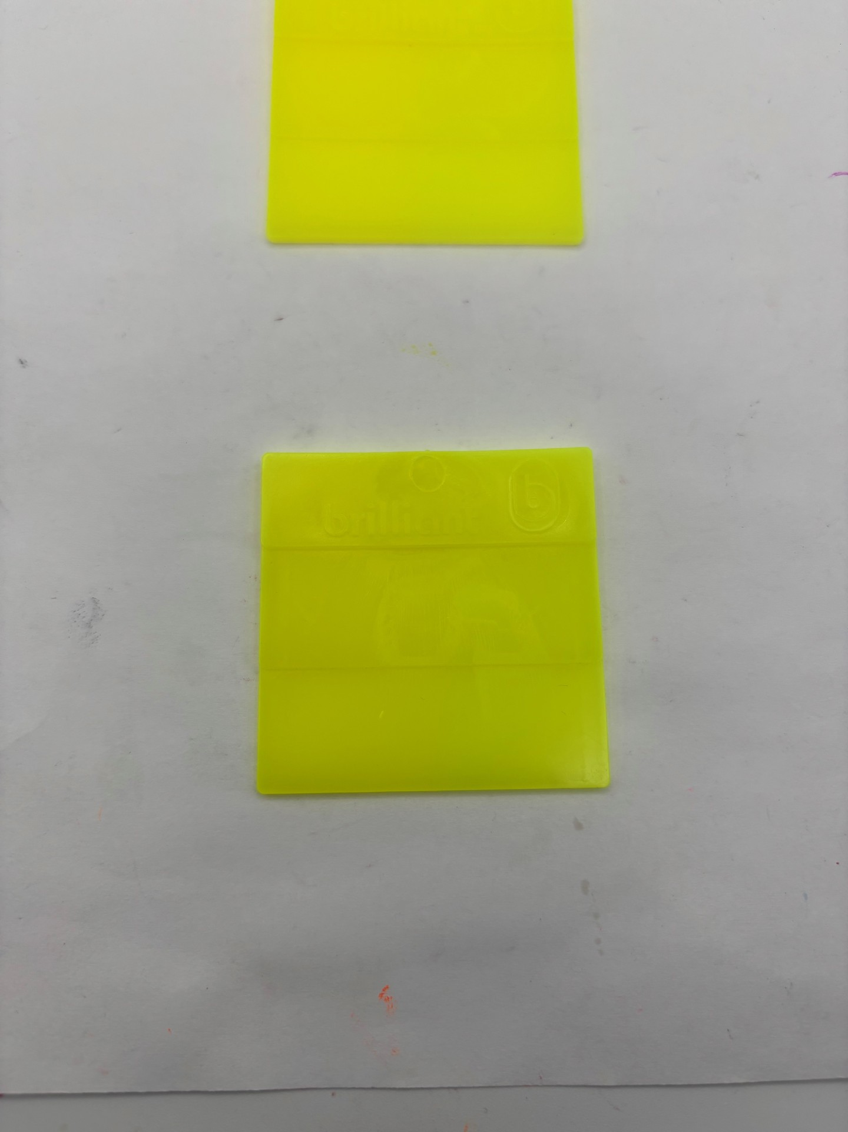
Lightfastness
BNF-CH527
BNF-CH527 Fine Grind
Exposed
Unexposed
Exposed
Unexposed
DE: 4.65
DE: 4.43

Slide 5
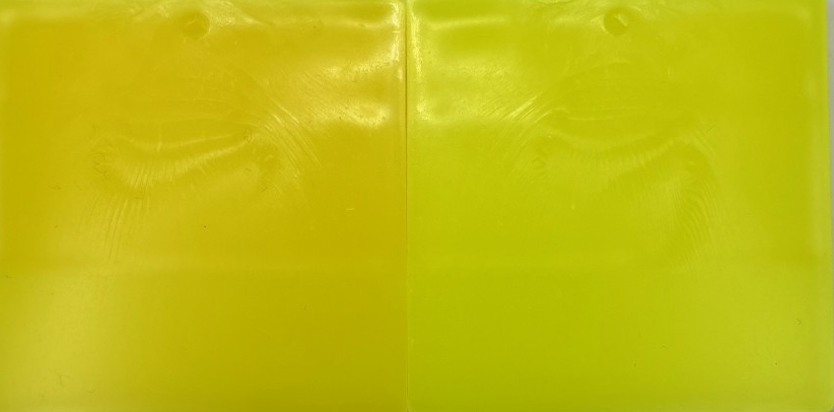
ZQ-17 vs BNF-CH527 FG
Heat Hold
ZQ-17
5 min, 300C Hold
Masstone
ZQ-17
BNF-CH527 FG
DE: 18.19
BNF-CH527 Fine Grind
5 min, 300C Hold
DE: 8.11

Slide 6
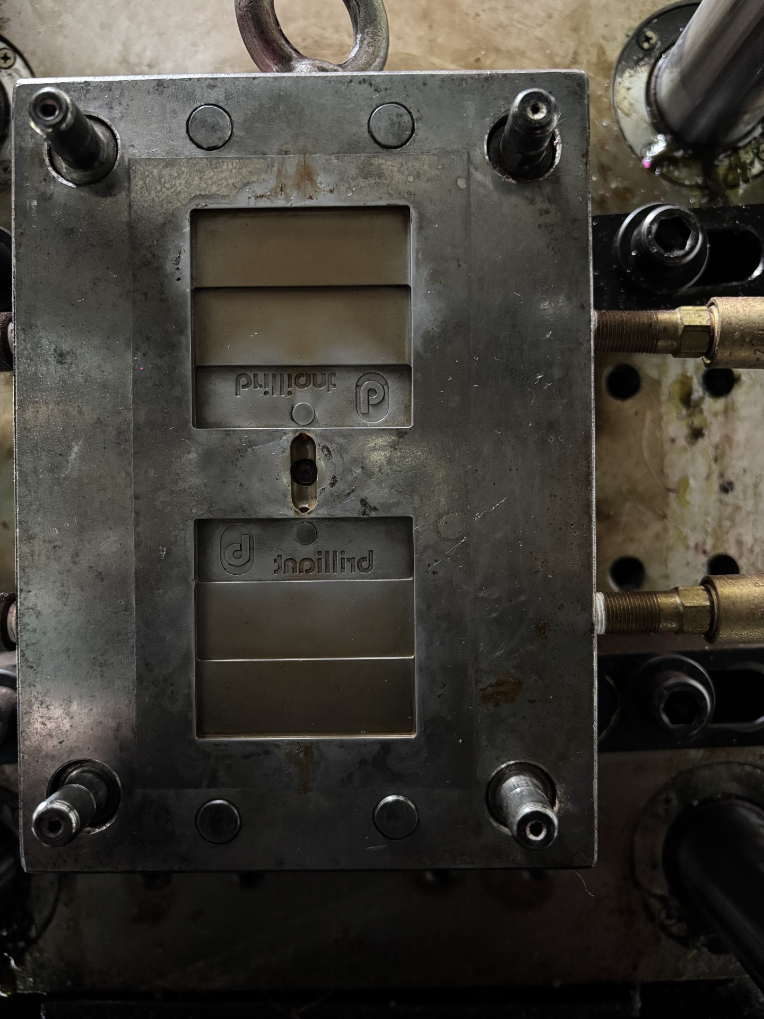
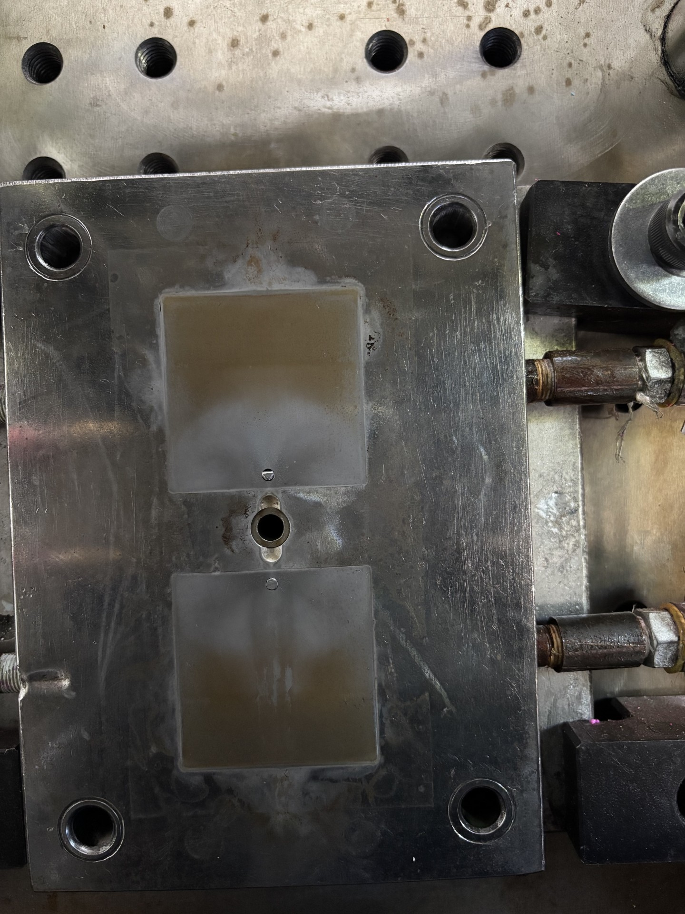
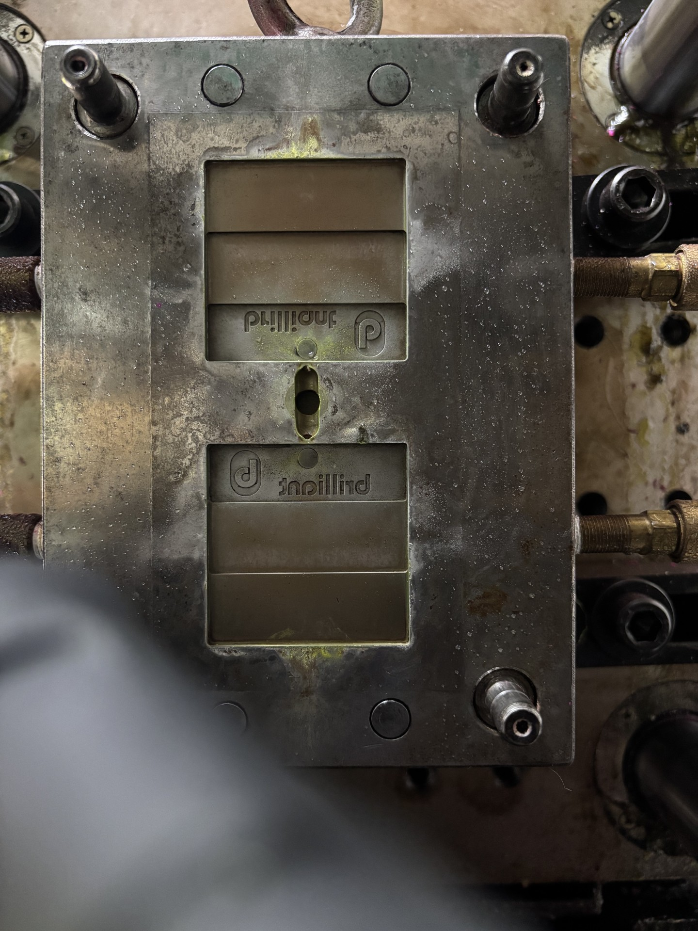
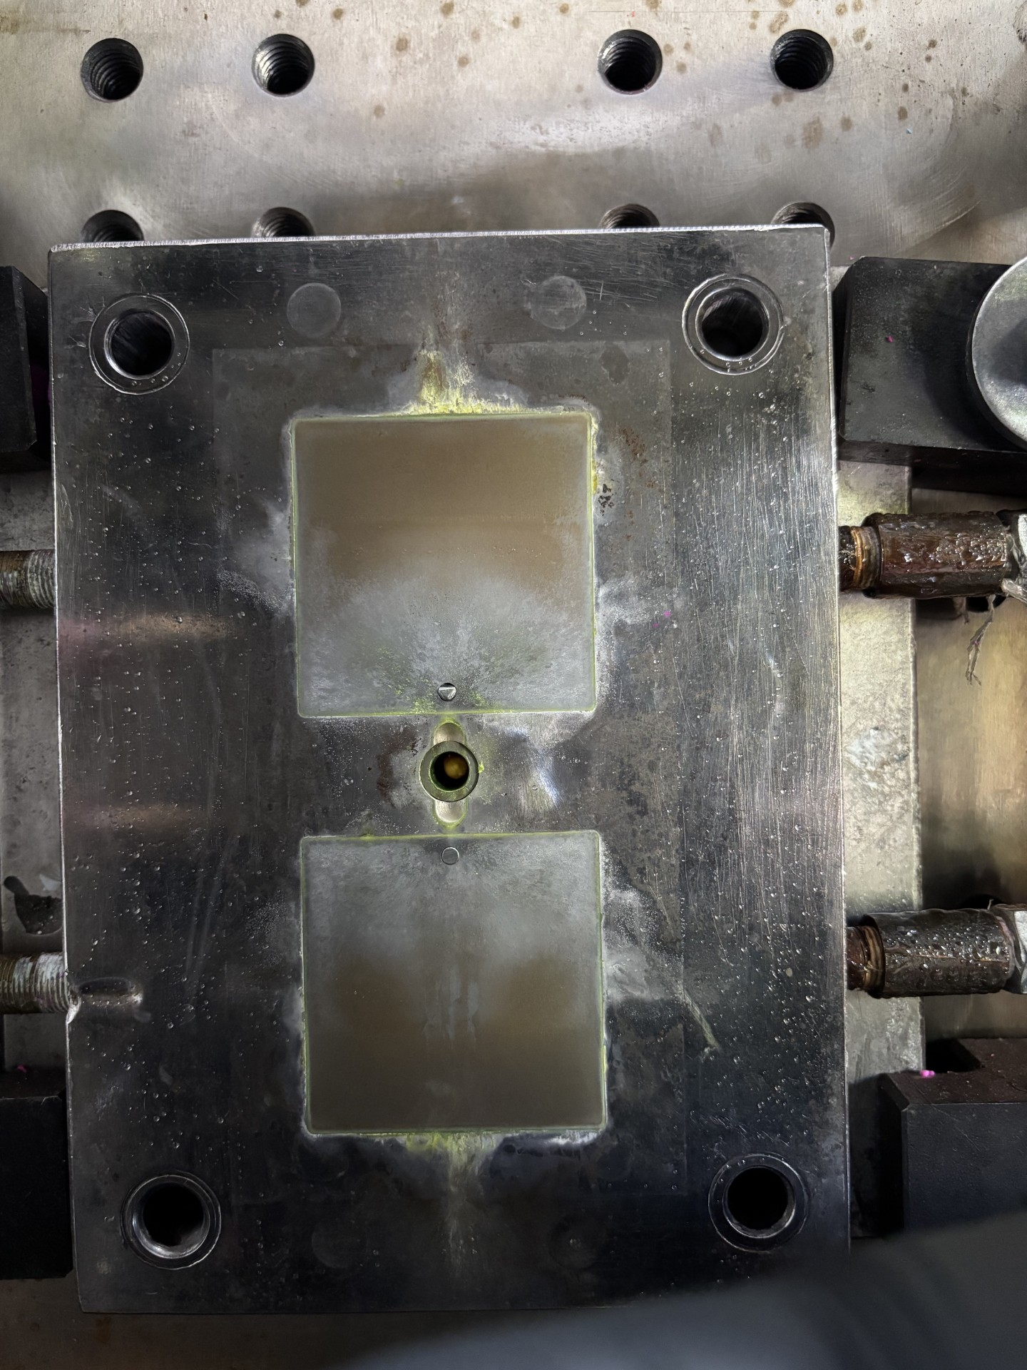
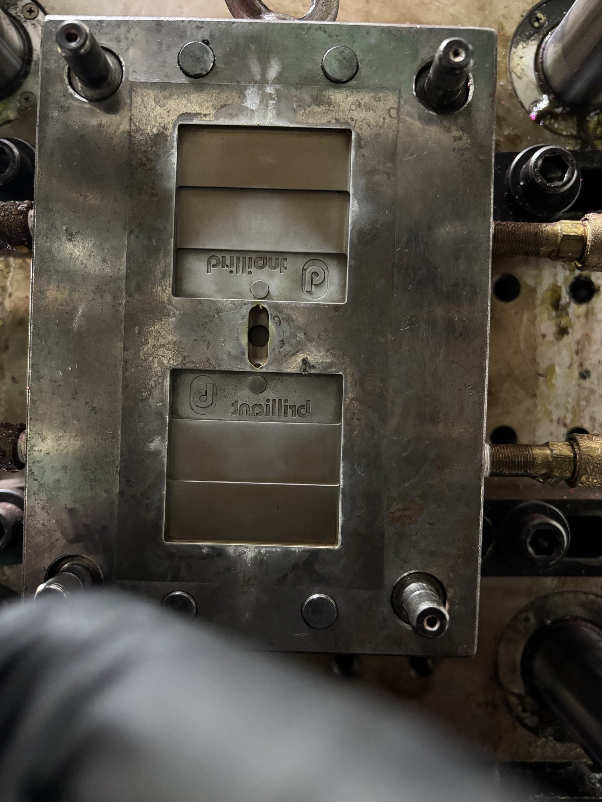
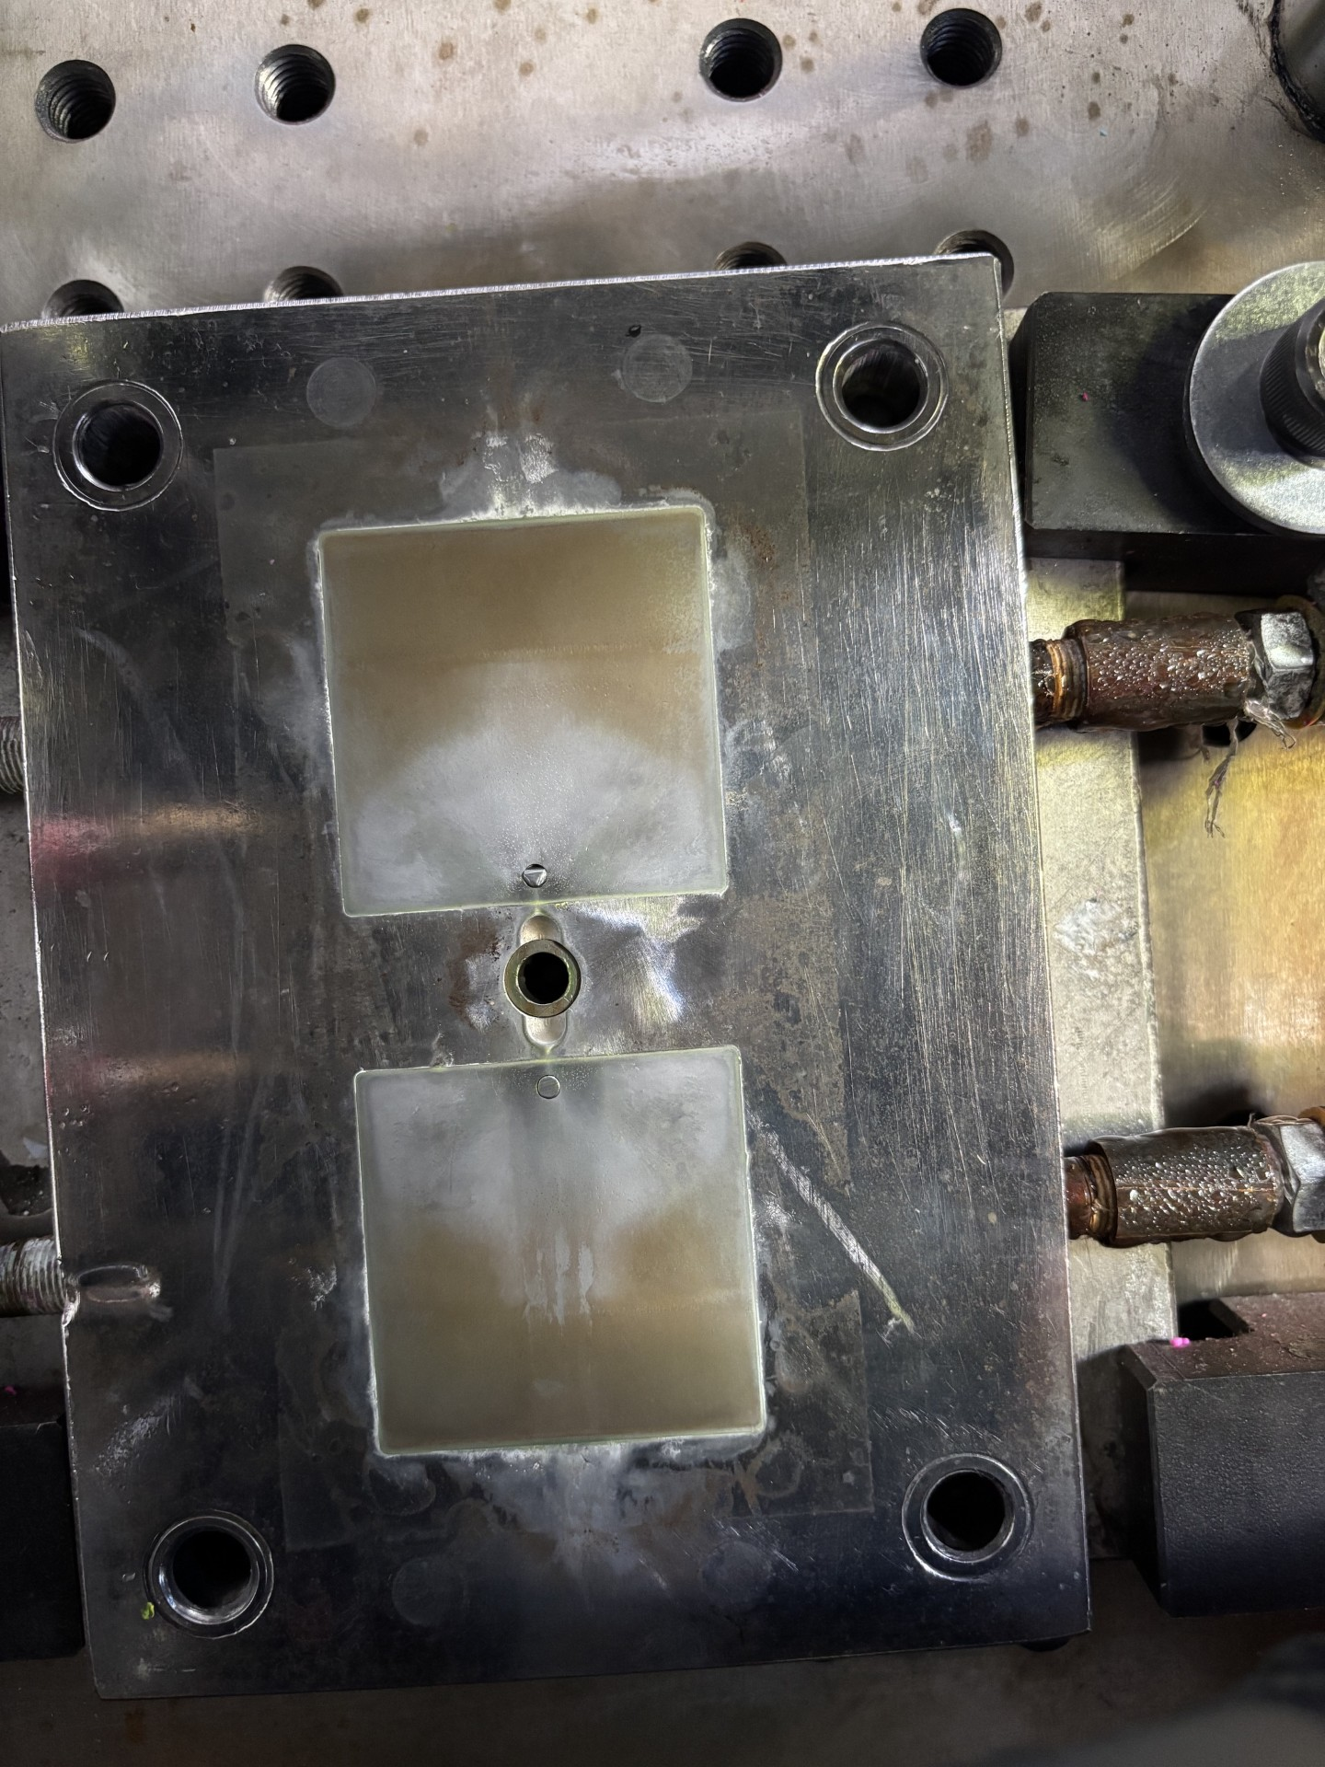
Long Plate out
40% 800g
Clean
STD BNF-CH527
BNF-CH527 FG

Slide 7
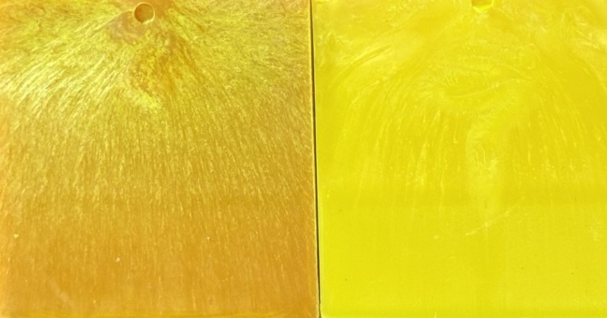
Long Plate out
40% 800g Chips
STD BNF-CH527
BNF-CH527 FG
Had to spoon feed.
Strands were very puffy.
Had to spoon feed.
Strands were uniform.
Both took similar time to extrude and mold.

